Slide 1
Stock Market
Predictions and Clustering
TASK 3
Update
STAT-656, April 2022
Abdullatif Alnuaimi
Pooja Hari Ambrish
Sachith Kumar Janjirala

Slide 2
What is the main scientific question (or questions) that you are trying to answer. Be specific!
Main Scientific Question:
For comparing metrics like P&E ratio and YoY growth, it is important that we do the comparison from among the companies belonging to the similar domain. For this, we need to already know if the given companies belong to the same domain.
We are trying to automatically identify this similarity among companies using the frequencies extracted from the seasonality inherent in the stock data of the companies. This is based on the assumption that companies belonging to the similar domain usually have similar market forces controlling them, therefore leading to similar frequencies in the seasonality of their stock prices.
Once we identify similar companies we then analyze those companies from among their similarity group by comparing metrics and their future stock performances.

Slide 3
Method?
For answering the scientific question proposed in the earlier slide, we are following the below approach:
Step 0: Perform any Data Wrangling if required and, plot and visualize the stock data for each of the companies.
Step 1: Extract time periods of stock data for each of the companies using Fast Fourier Transforms and select the top n significant frequencies.
Step 2: Using the top n significant frequencies from Step 1, perform clustering on the companies and obtain k clusters of companies.
Step 3: For each of the companies, each of the k clusters obtained from Step 2, perform forecasting using ARIMA(Autoregressive Integrated Moving Average).
Step 4: For each of the k clusters obtained in Step 2, compare the companies within the clusters using metrics and their future stock performances.

Slide 4
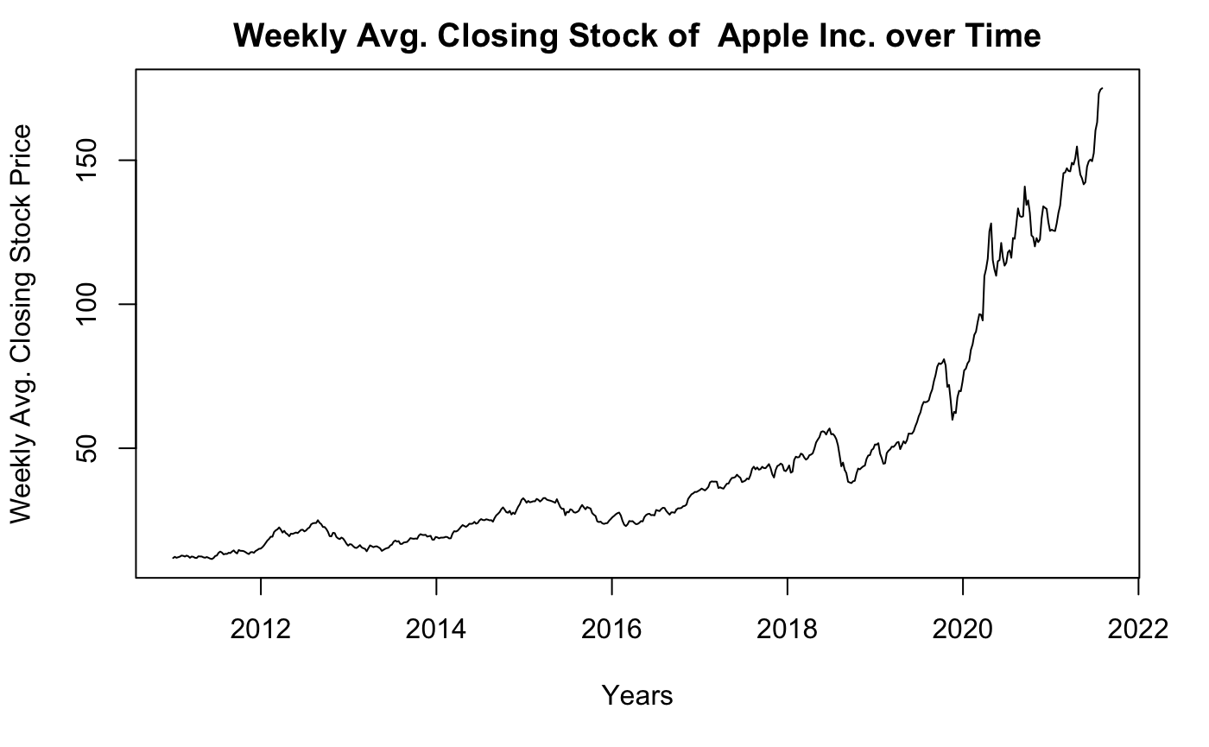
Method?
STEP 0:
We have missing values on every weekend in our data. We solve this problem of missing data by averaging over the week for the closing stock value and taking the data on a weekly basis instead of daily basses.
We have plot the time series for the closing stock price for each of the companies.

Slide 5
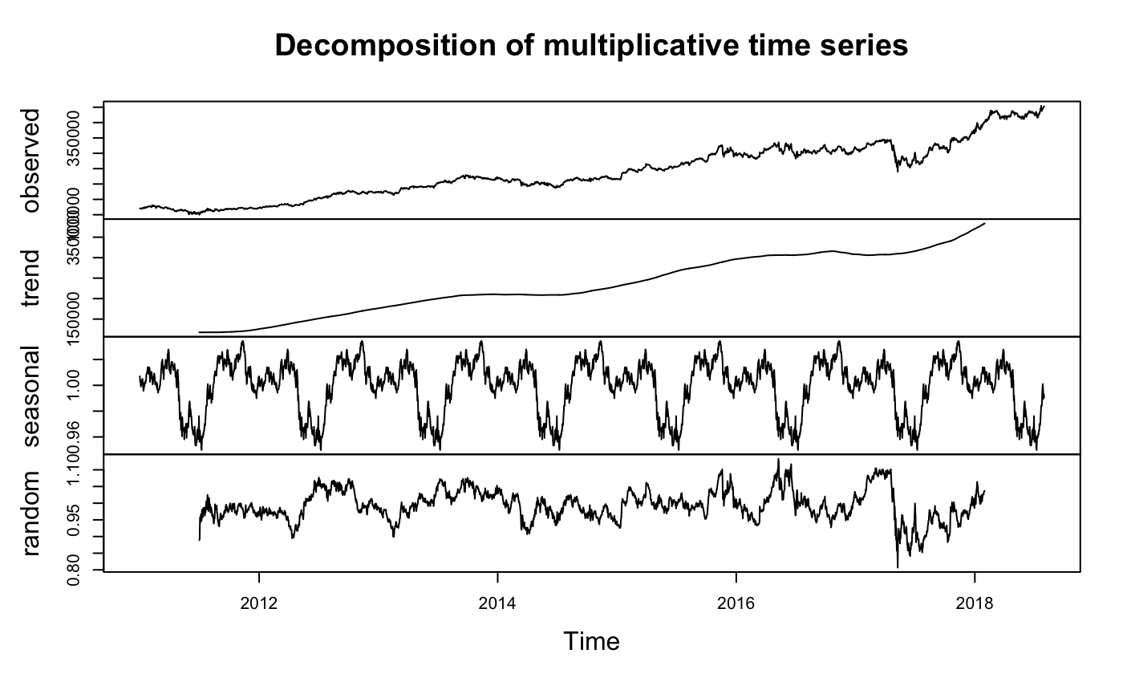
Method?
STEP 0:
We have also decomposed the time series stock data for each of the company using the decompose() function by using the ‘multiplicative model’ based on the observations made from the time series plots earlier.
The decompose() function in R yields 3 components of the time series: trend, seasonal and random, along with the observed. We plot these all together using the plot() function in R.

Slide 6
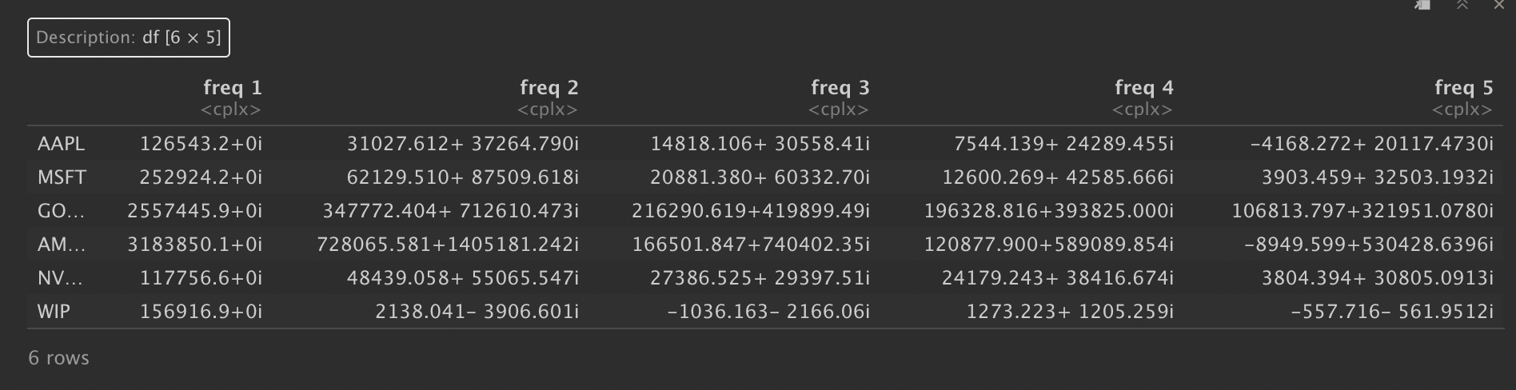
Method?
STEP 1:
We first extract the seasonality frequencies from the stock data for each of the companies using the Fast Fourier Transforms, which can be implemented in R using the fft() function. The output of this function gives us a long list of frequencies from which we pick the top n significant frequencies for our next step.
In the below output we can see the top 3 frequencies for 6 companies.

Slide 7
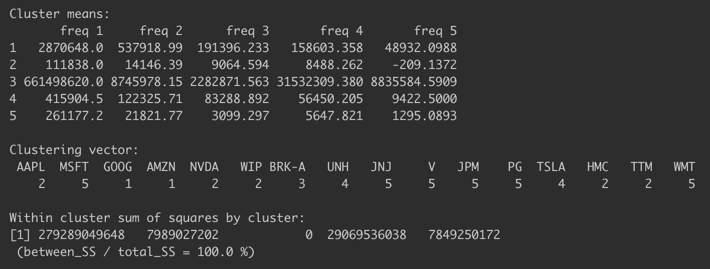
Method?
STEP 2:
Using the top n significant frequencies from Step 1, we perform clustering on the companies and obtain k clusters of companies.
We were using k-means clustering by selecting k = 5. We have selected k = 5 as it is the optimal value.

Slide 8
Method?
STEP 3:
For each of the companies for each of the k clusters obtained from Step 2, perform forecasting using linear regression.
For Forecasting we use ARIMA (autoregressive integrated moving average).
ARIMA is a commonly used technique utilized to fit time series data and forecasting. It is a generalized version of ARMA (autoregressive moving average) process, where the ARMA process is applied for a differenced version of the data rather than original.

Slide 9
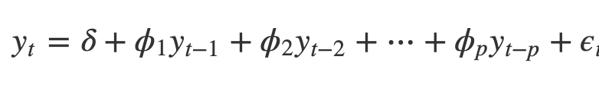
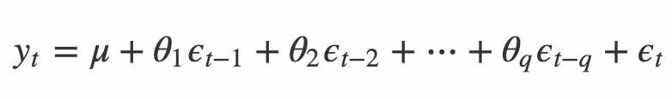
Method?
STEP 3:
For each of the companies for each of the k clusters obtained from Step 2, perform forecasting using linear regression.
Three numbers p, d and q specify ARIMA model and the ARIMA model is said to be of order (p, d, q). Here p, d, and q are the orders of AR part, Difference and the MA part respectively.
AR and MA - both are different techniques to fit time series data. ARMA (and ARIMA) is a combination of these two methods for better fit of the model.
AR (Auto Regression):
MA (Moving Average):

Slide 10
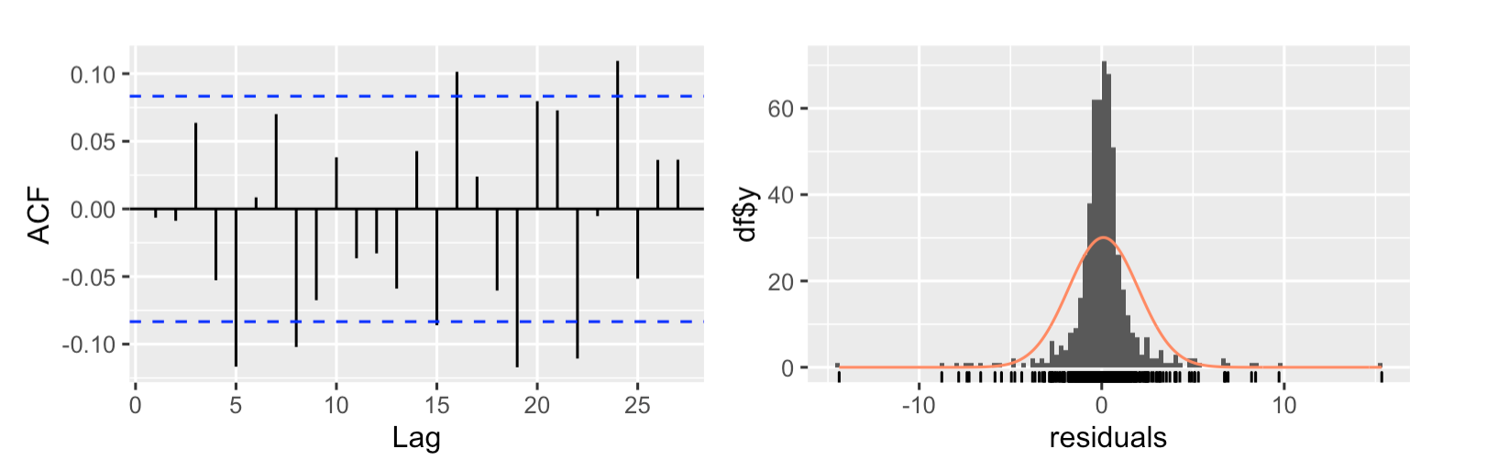
Method?
STEP 3:
The prediction intervals for ARIMA models are based on assumptions that the residuals are uncorrelated and normally distributed. We check two plots before producing prediction intervals: the ACF and histogram of the residuals.

Slide 11
Method?
STEP 3:
We can select the best arima plot based by observing the ACF and later plotting PACF plot and then selecting d, p and q values.
Once we select d, p, and q values, we will be able to perform ARIMA on the timeseries: for example arima models : ARIMA(0, 1, 2), ARIMA(1, 1, 0) and ARIMA(1, 1, 2)
However, we can just use the auto.arima() function in R to automatically pick the best ARIMA model without us having to manually choose any parameters.
We can then pass this arima model in the forecast function as:
forecast(arima_model) or using forward pipe operator ‘%>%’ and plot it using autoplot() function.

Slide 12
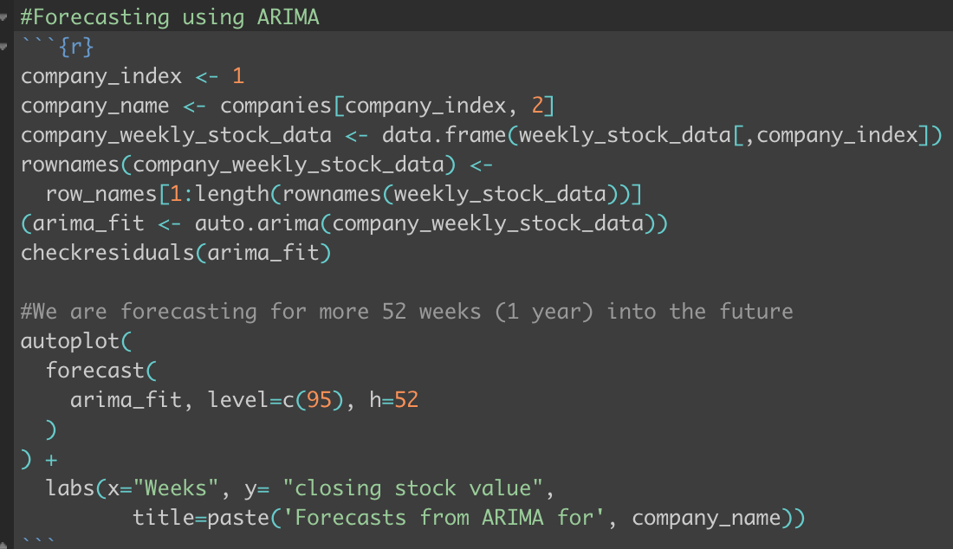
Method?
STEP 3:
The below is an example code of the model and its output.
Here we are forecast to predict Apple company stock price:

Slide 13
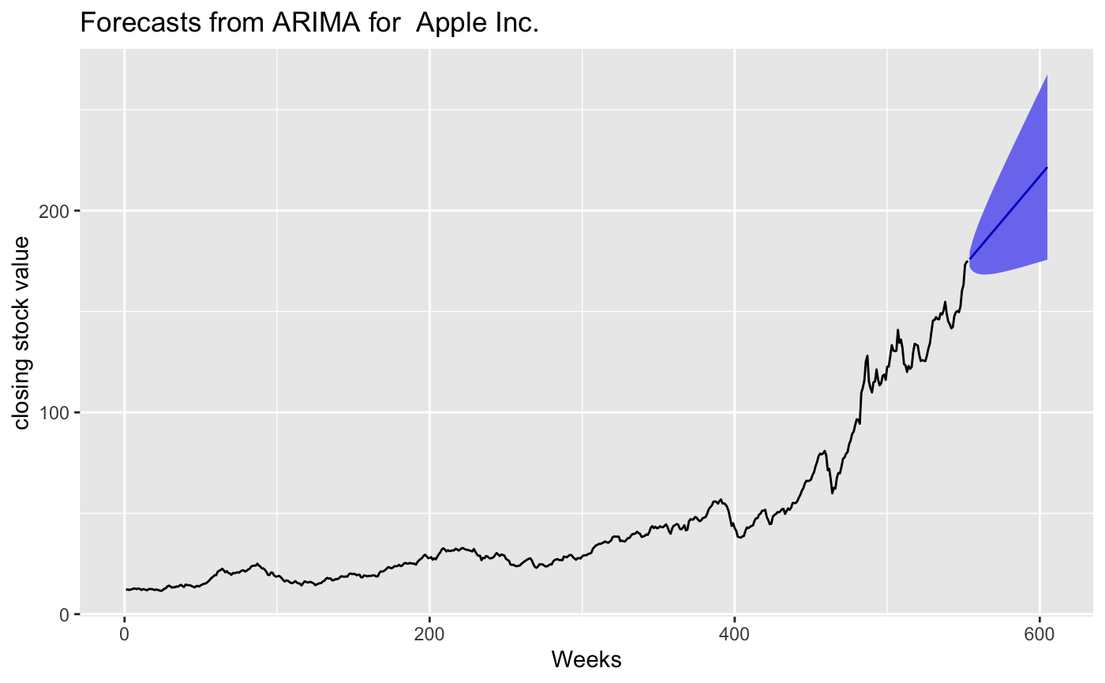
Method?
STEP 3:
The below is an plot for the code in the previous slide.
Here we are trying to forecast Apple company stock price:

Slide 14
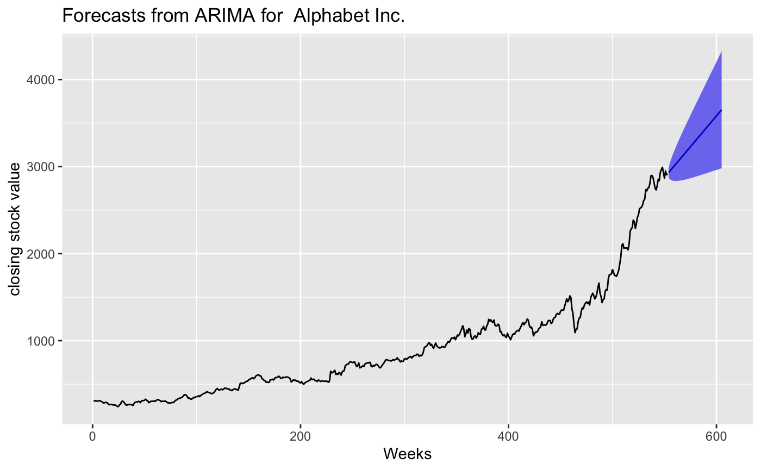
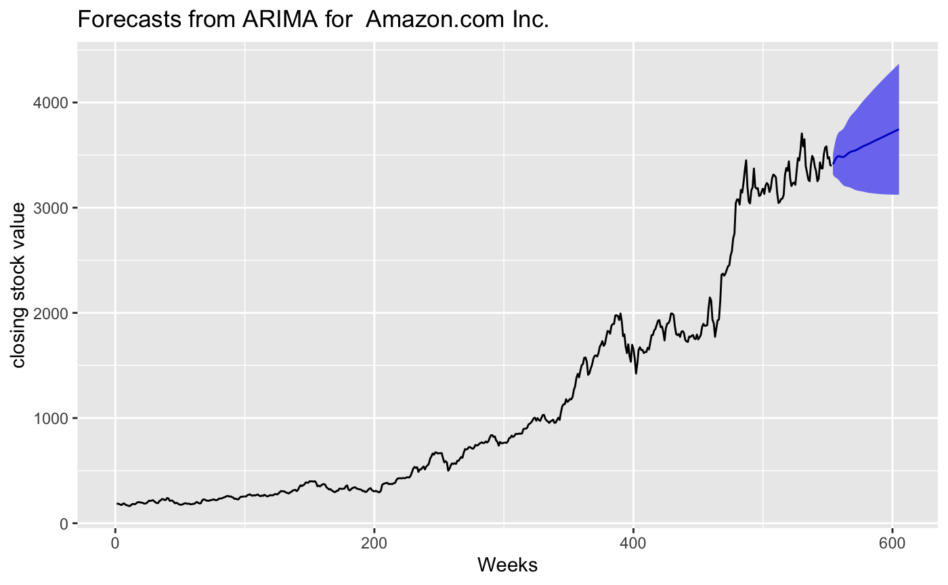
Method?
STEP 4:
For each of the k clusters obtained in Step 2, we compare the companies within the clusters using metrics and their future stock performances.
Here we indicate comparing of the future stock performance for the companies belonging to one of the cluster: GOOG and AMZN

Slide 15
What is the most interesting (to you) thing you have discovered so far about your main scientific question(s)?
From the analysis done in this project, we can conclude that grouping the companies into domains of similarity just based on the similarity in their seasonality of their stock prices is not a reliable way to group them because the companies actually belonging to the same domain like Apple, Alphabet(formerly known as Google), Microsoft, and Amazon have been placed into 2 different clusters.
Therefore, we need to have prior knowledge from the real world to be able to group the companies into similar domains viz; companies like Apple, Microsoft and Google belong to the Tech. domain and companies like Tesla, Honda, and Tata Motors belong to the Automotive industry.
We are yet to do analysis of the companies within the clusters using metrics like P&E ratio and YoY growth, we are hoping to do this for the next Task of the project.

Slide 16
Any questions you have for me going forward with your project.
Now that we have concluded that grouping companies based on the similarity of their seasonality of their stock prices is not reliable and established that we need to have the knowledge from the real world to identify which group the company belongs to, is there any other way in which it would be possible for us to identify groups of companies belonging to similar domain by just inferring from the data, without the need to have prior knowledge from the real world about the company?
In the data extracted from the Yahoo Finance we have missing values for the stock data on all the weekends. We have solved the problem of this missing values by averaging the stock price over the week for every week and considering data as weekly data. Is this a good approach or would you suggest any data imputation techniques or any other way to solve the problem of this missing values?

Slide 17
Thank You!

